Slide 1
Amanuensis
Angel
Poems inspired by Abstract Expressionist, Surrealist, and Symbolist Artists in their depictions of angels.
By Roy Beckemeyer

Slide 2
Amanuensis
Angel
Poems inspired by Abstract Expressionist, Surrealist, and Symbolist Artists in their depictions of angels.
By Roy Beckemeyer

Slide 3
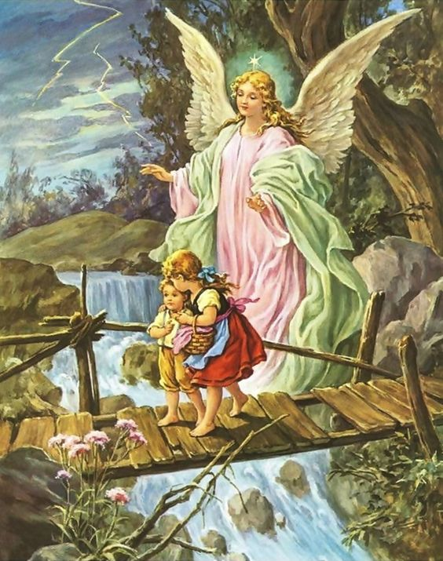
As a child in a Catholic household, my siblings and I grew up with this old
picture hanging on the wall of our bedroom. It was comforting to us. One
of the first poems I can recall learning was the Guardian Angel prayer:
  “Angel of God,
  my Guardian dear,
  to whom His love
  commits me here,
  ever this day
  be at my side,
  to light and guard,
  to rule and guide.
  Amen.”

Slide 4
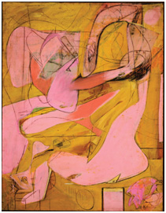
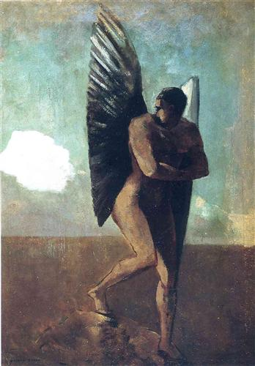
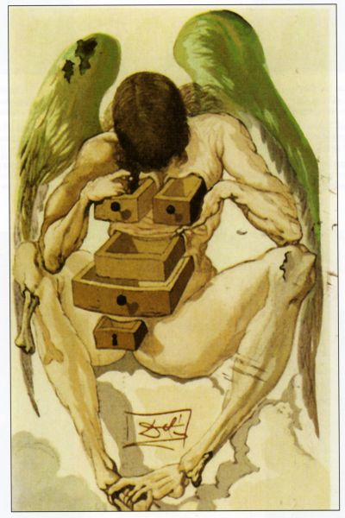
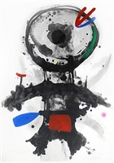
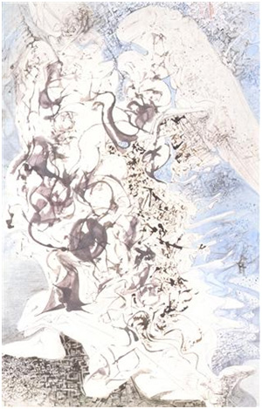
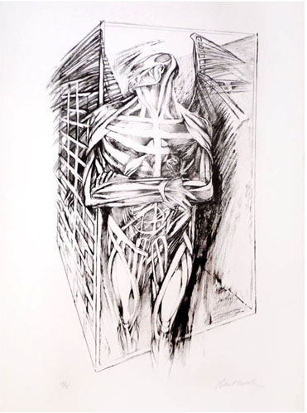
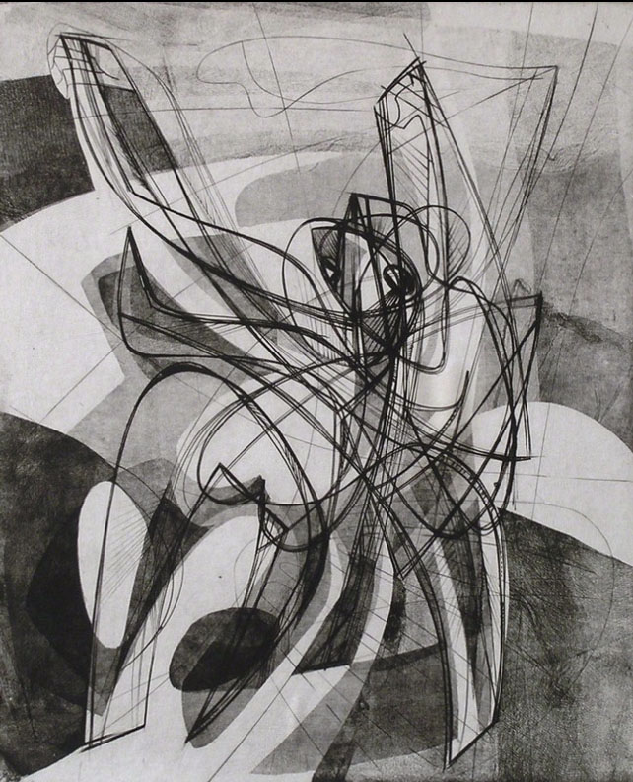
Not all artists have had a comforting
vision of angels, though. This book of
poems addresses some of those other
kinds of angel depictions. My responses,
some reverent, some irreverent, some
serious, some
humorous, are
presented here.

Slide 5
Angel of Chaos
"Angel“ by Salvadore Dali, c.1958, Abstract Expressionism, Symbolism

Slide 6
Amanuensis Angel
Salvador Dali, Purgatory: Canto 1 "The Fallen Angel" from The Divine Comedy, Wood Block Engraving 1960, 13” x 10.5”

Slide 7
The Riddled Angel
Joan Miró, “L' Ange Crible, (The Riddled Angel)” 1973

Slide 8
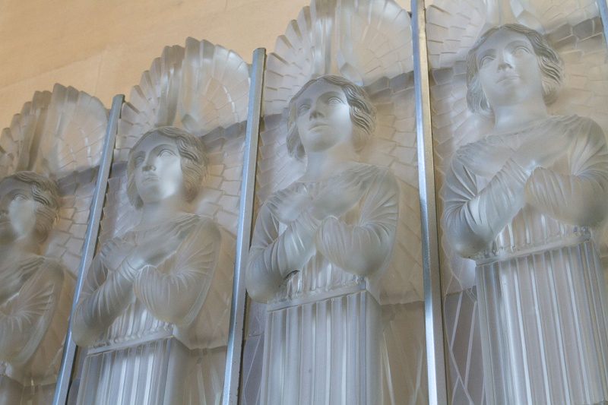
Glass Choir
Rene Lalique's glass altar-piece sculpture of angels, St. Matthew's Church, Millbrook, Jersey

Slide 9
Pink Angels
Willem De Kooning's “Pink Angels,” around 1945. Frederick R. Weisman Art Foundation, Los Angeles

Slide 10
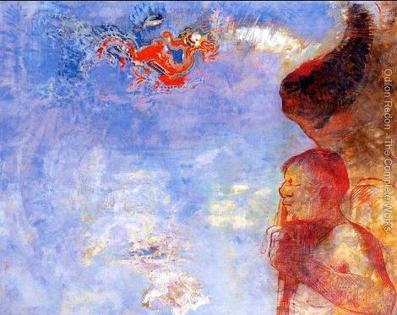
The Dark Wages of Angelic Sin
Odilon Redon's "The Fallen Angel," 1905

Slide 11
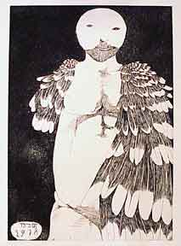
Teshuvah Angel
Yom Kippur Angel. Baskin, Leonard (1922-2000) New York: 1978, Etching and aquatint.

Slide 12
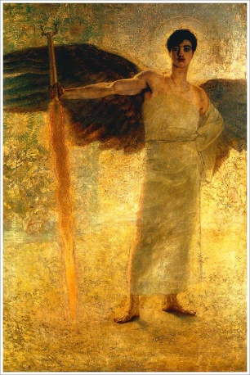
En Garde!
Franz von Stuck's oil painting, "The Guardian of Paradise"

Slide 13
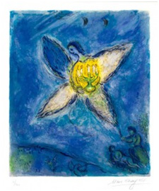
Angels Ablaze
Mark Chagall, L’ange au chandelier (Angel with Candlestick) 1973
Color Lithograph

Slide 14
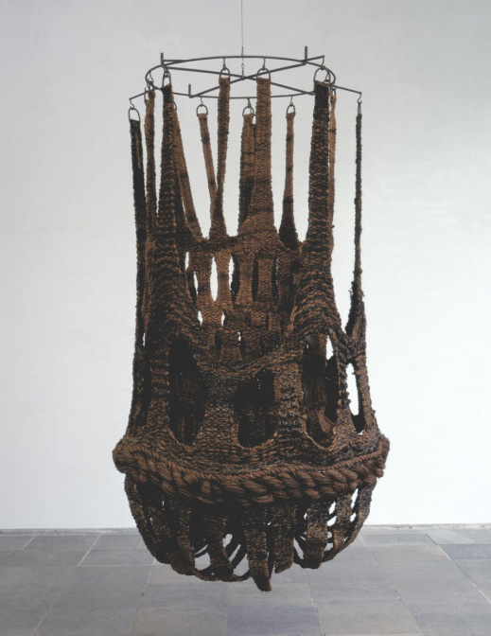
Angel, Falling
Croatian artist Jagoda Buic’s “Fallen Angel” 1967 Fiber: Sculpture 1960-present 2014 Exhibit at Boston’s Institute of Contemporary Art

Slide 15
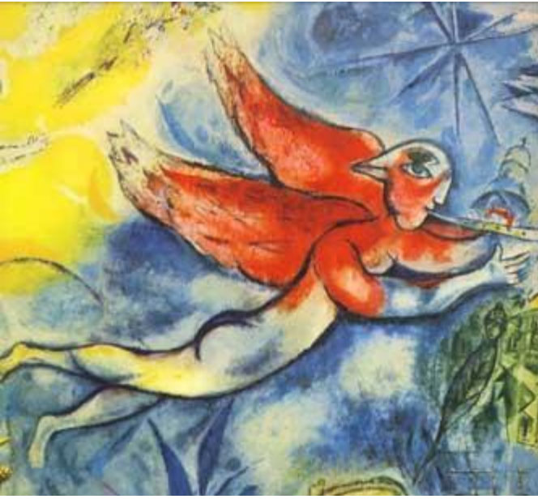
Angel, Wings Aflame
Marc Chagall (1887-1985) Mussorgsky's Boris Godunov Angel Detail from Mural on the Ceiling of the Opera Garnier, Paris, 1964.

Slide 16
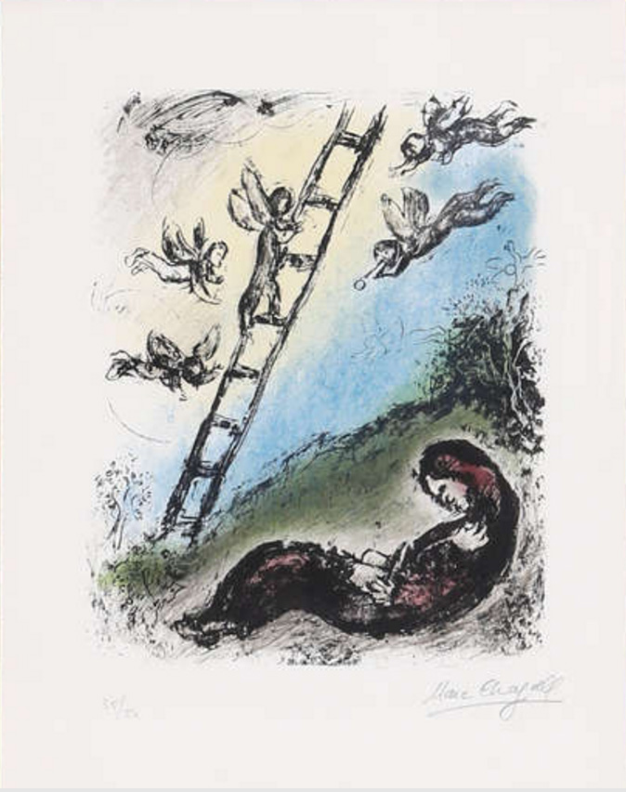
Jacob's Angels
Marc Chagall (1887 - 1985) Jacob and the Angels (M. 966) Year: 1980 Lithograph on Arches
Edition: 50

Slide 17
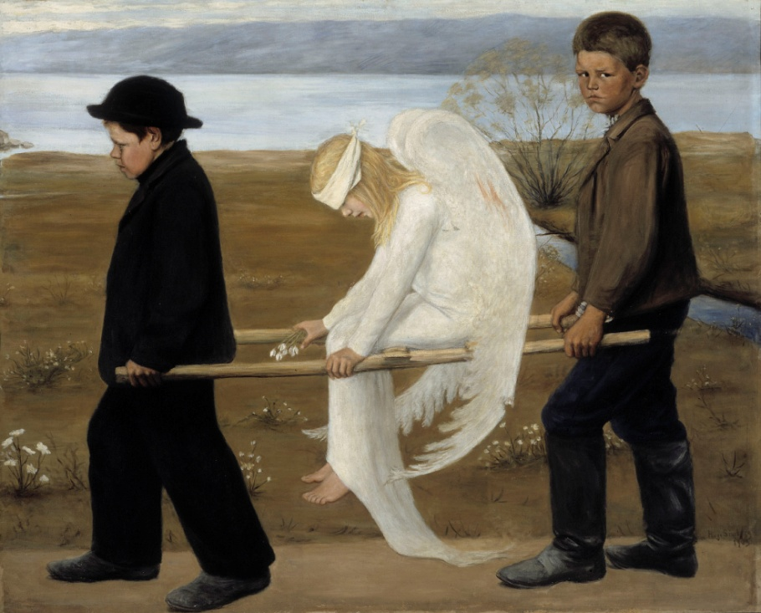
Imbrued Angels
The Wounded Angel Hugo Simberg (1873-1917) Finnish Symbolist Painter 1903, Oil
Ateneum, Helsinki

Slide 18
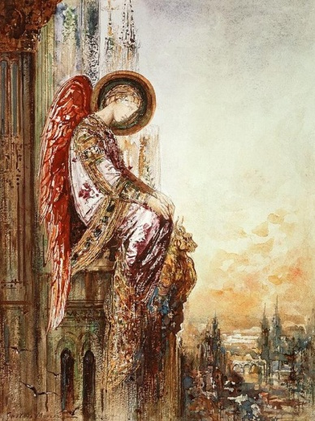
Touristique
Gutave Moreau's watercolor, "Angel Traveler"

Slide 19
Angels Fallen from Clouds
Fallen Angel Looking at a Cloud French Artist Odilon Redon c.1875 Symbolism Oil on Canvas
Stedelijk Museum, Amsterdam

Slide 20
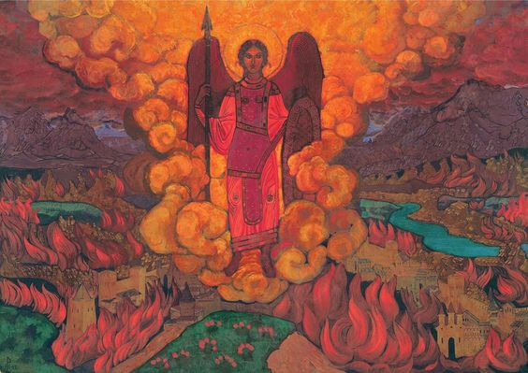
The Last Angel
Nicholas Roerich's painting, "The Last Angel"

Slide 21
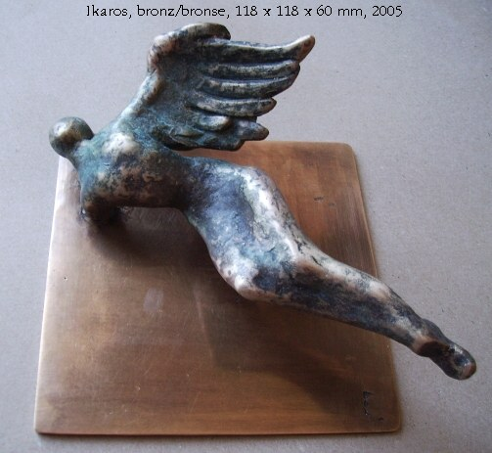
Angel Forensics
Marie Šeborová's bronze sculpture, "Ikaros"

Slide 22
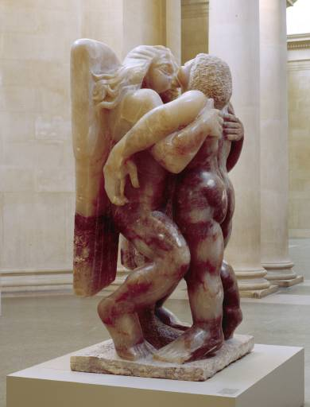
Jacob and the Angel
Sir Jacob Epstein Jacob and the Angel Alabaster 1940-1

Slide 23
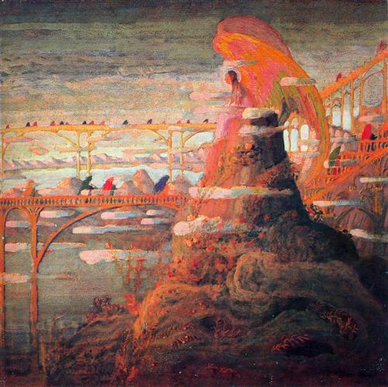
Vespers
'"Angel Prelude“ Mikalojus Ciurlionis Lithuanian artist and composer 1909.

Slide 24
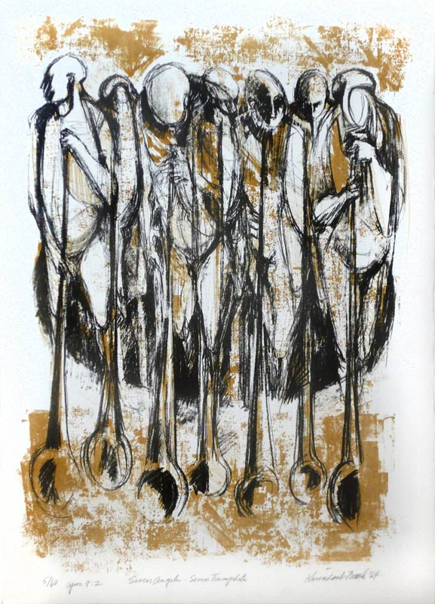
Remembering Louis Armstrong at Perdition
Karen Laub-Novak’s print, “Apocalypse IX: Seven Angels, Seven Trumpets”

Slide 25
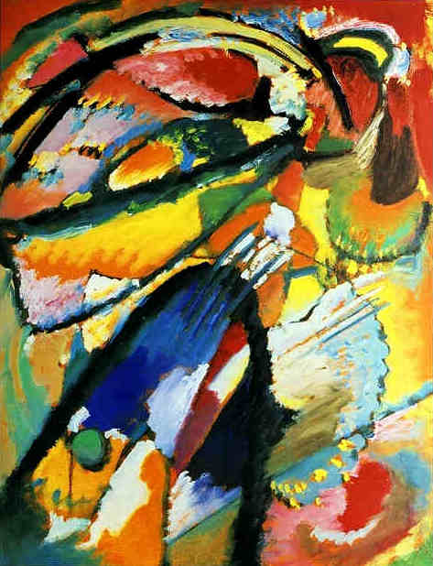
Angels and Judgment
Wassily Kandinsky Angel of the Last Judgment, 1911 Oil on cardboard, 25.2 × 19.7" Switzerland. The Merzbacher Collection

Slide 26
Evidence
STANLEY WILLIAM HAYTER Angels Wrestling, 1950
Engraving & soft ground etching Edition of 50

Slide 27
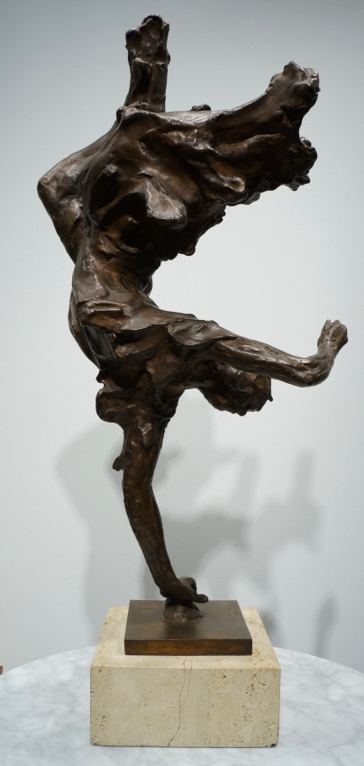
Beth Hesda Angel
Paul Granlund’s bronze “The Bethesda Angel,” 1968.

Slide 28
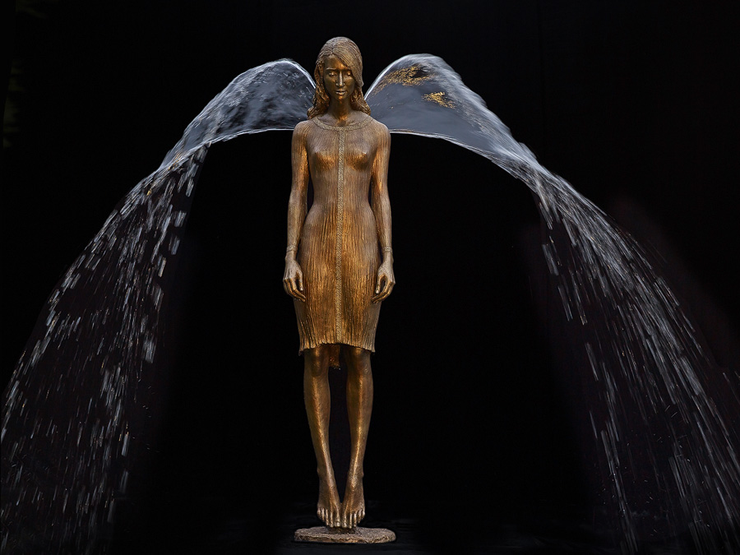
Water-wing Angel
Malgorzata-Chodakowska’s figural fountain, “Engel”

Slide 29
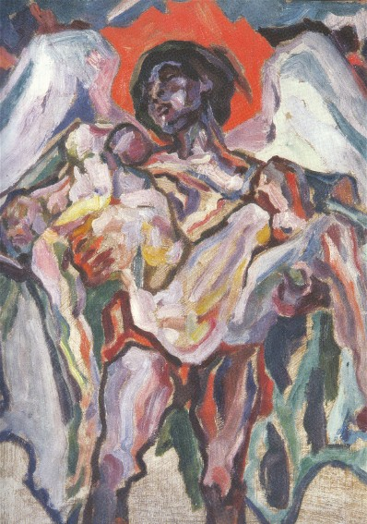
The Angel of Death’s Penance
Oleksa Novakivsky's painting, "Angel of Death," 1923

Slide 30
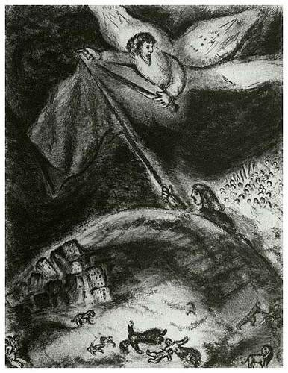
Forward Angel Control
Marc Chagall Original etching on Montval paper Oracle Over Babylon
The Bible Etchings 1956, Edition: 275

Slide 31
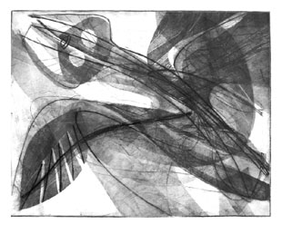
Angels of the Night
Black Angel - 1950 Stanley William Hayter, 1901-1988
Printed in black on Arches paper, hand signed, edition of 13 copies

Slide 32
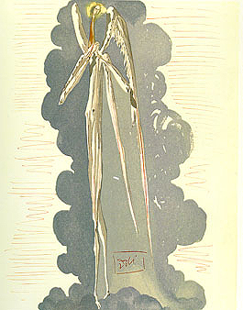
Septimus Angelus
Salvador Dali Paradise: Canto 22"The Angel of the 7th Heaven"
from The Divine Comedy Wood Block Engraving - 1960

Slide 33
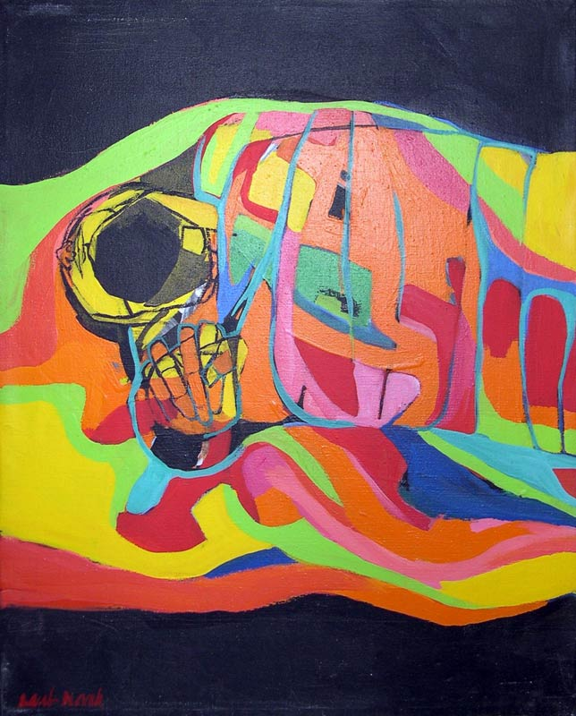
Subversion
After Karen Laub-Novak’s painting, “Fallen Angel” (Excerpt)

Slide 34
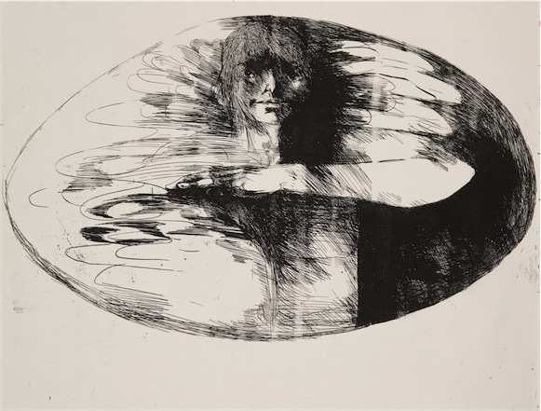
Benevolent Angel
Leonard Baskin, (1922-2000) American Artist Benevolent Angel
Etching Utah Museum of Fine Arts

Slide 35
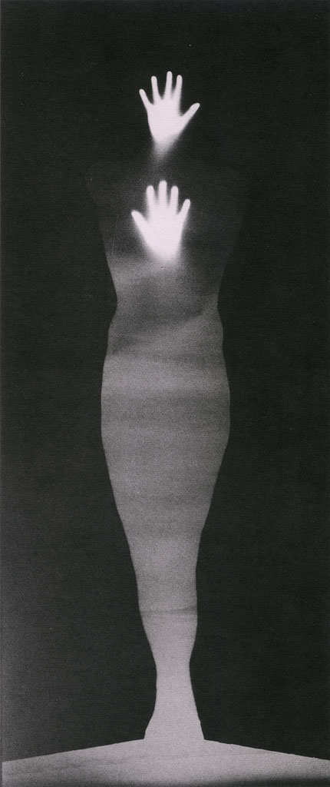
Conguero Angel
Bruce Conner "Sound of Two Hand Angel," 1974. Museum of Contemporary Art, Los Angeles Conner created this "photogram," by placing his own body in front of photographic paper and shining a light on himself. "Sound of Two Hand Angel" shows Conner emerging from darkness, his body seemingly made of light.

Slide 36
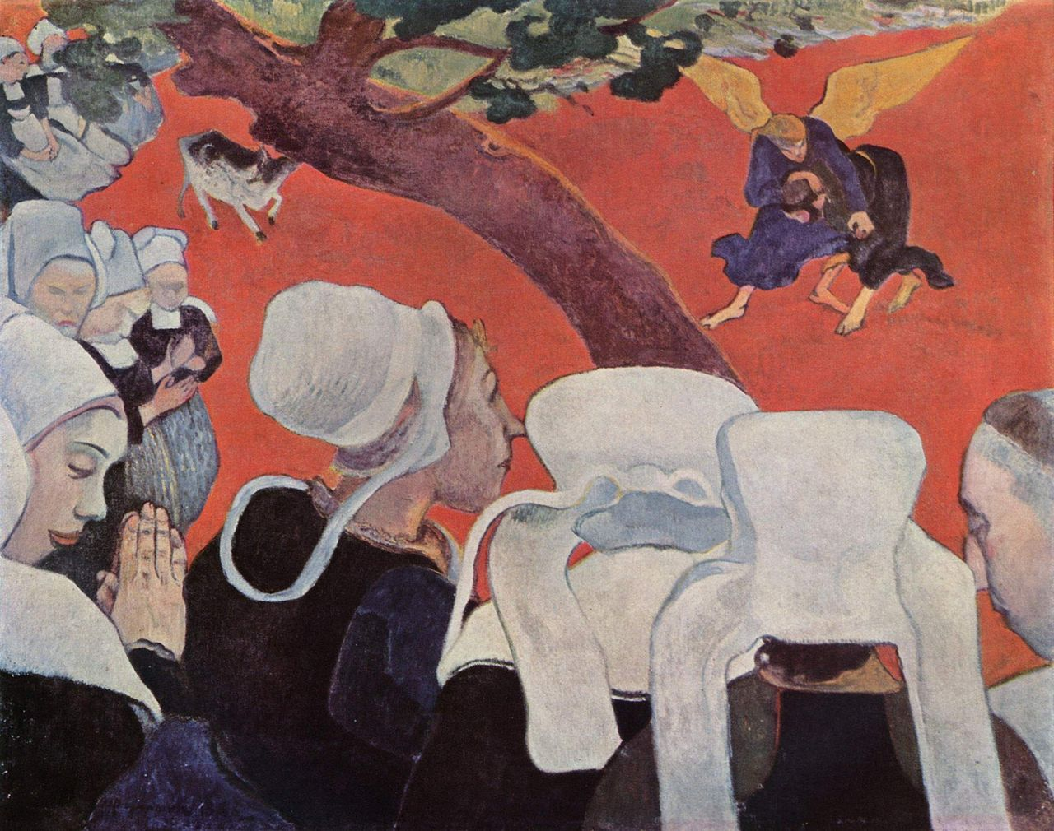
Vision After a Sermon
Vision After the Sermon Paul Gauguin 1888 Oil on canvas
National Gallery of Scotland, Edinburg

Slide 37
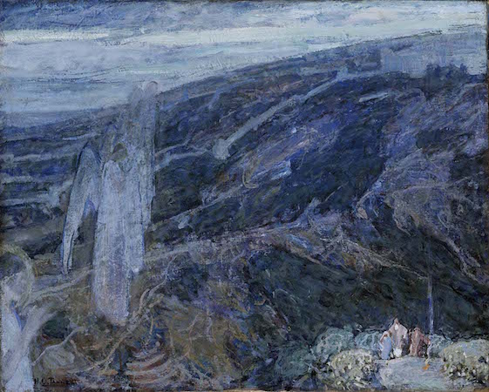
Angel Storm Front
Henry Ossawa Tanner's Oil on canvas, "Angels Appearing before the Shepherds,"
Smithsonian, c. 1910

Slide 38
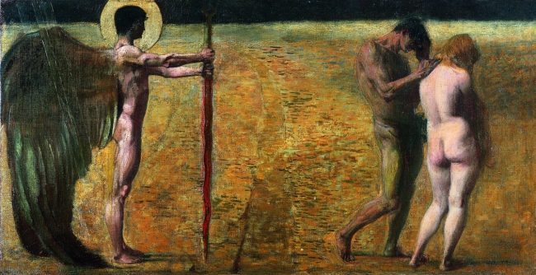
ADAM OBSERVES THE EXPULSION ANGEL
Franz von Stuck's, "Expulsion from Paradise“
Staatliche Kunstsammlung, Dresden, 1891

Slide 39
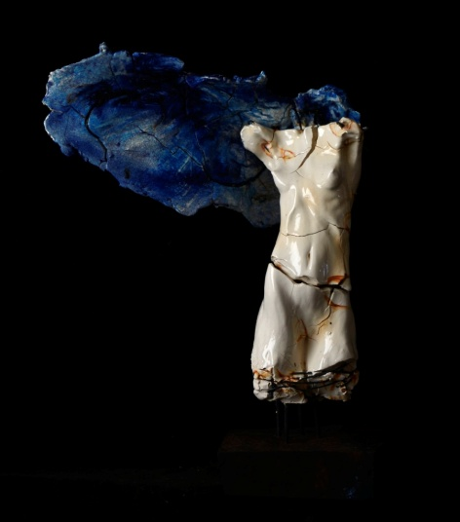
Blue-winged Angel
Carl Dahl's porcelain "Blue-winged female angel," 2014

Slide 40
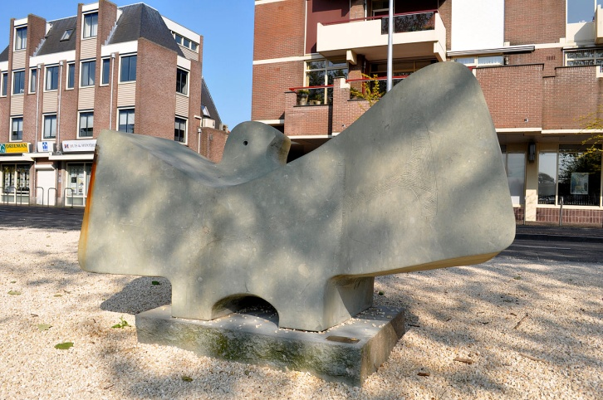
Engel
Marie Šeborová's stone sculpture, "Engel," 2007,
at the harbor in Meulmansweg, the Netherlands.

Slide 41
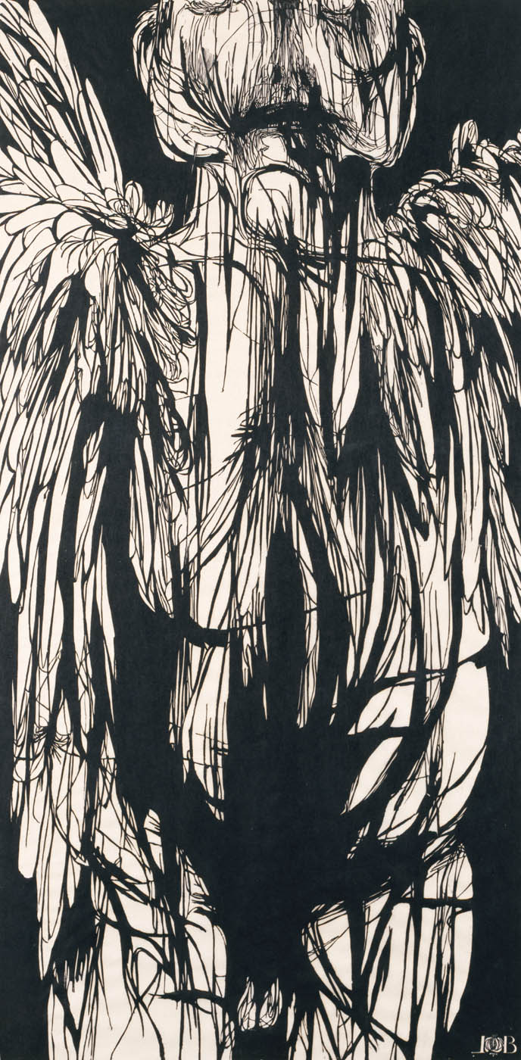
Dead Angel of Death
Leonard Baskin's Woodcut “Angel of Death," Smithsonian 1959

Slide 42
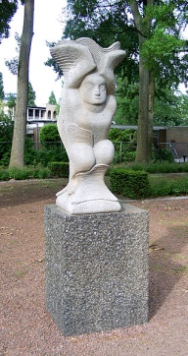
Dragstrip Angel
Willem Reijers' sculpture "Engel," 1945,
Martin Luther King Park, Amsterdam.

Slide 43
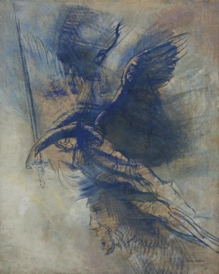
Warrior Angel
Odilon Redon's painting, "L'ange Guerrier"

Slide 44
Closet Angel
Karen Laub-Novak's Print, "Angel of the Second Elegy," 1970's

Slide 45
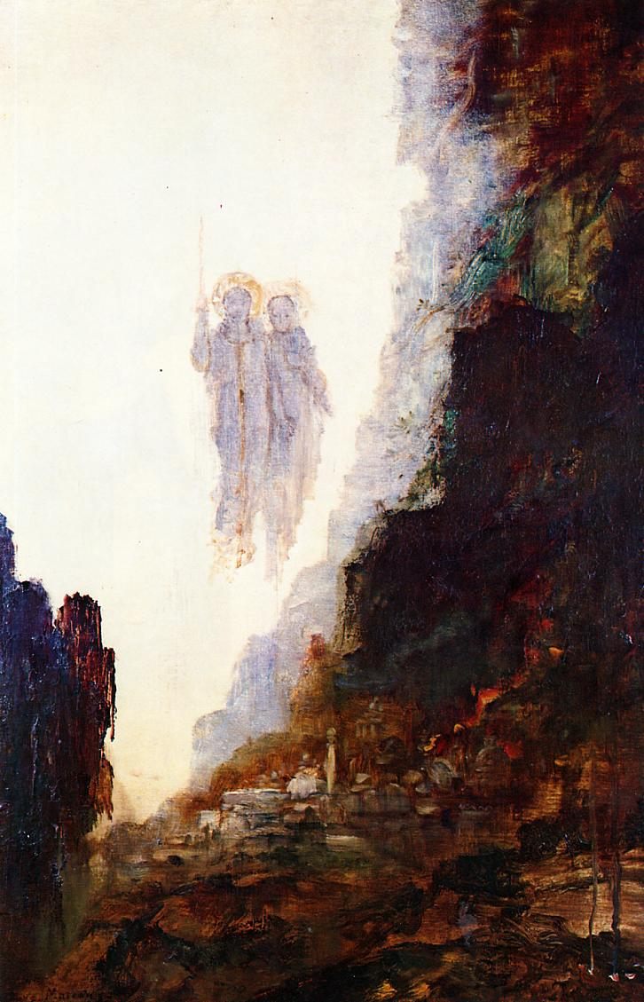
Rock Salt and Angels
"The Angels of Sodom," by Gustave Moreau, 1890.

Slide 46
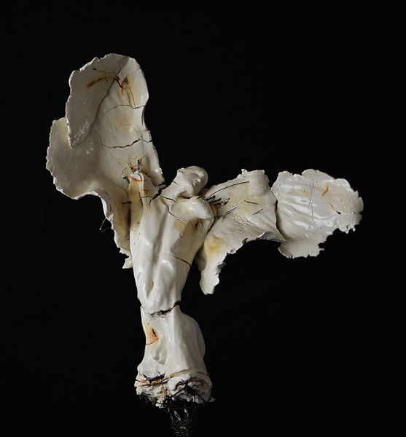
Bereft Angel
Carl Dahl Porcelain Angel Sculpture Contemporary

Slide 47
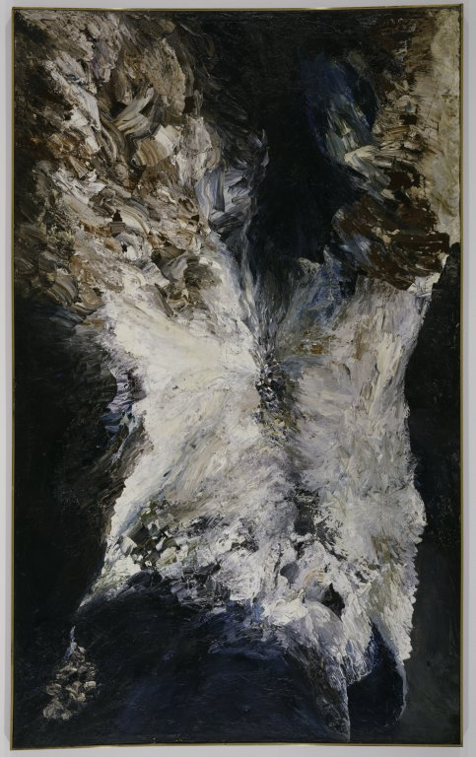
Annunciation Angel
Jay DeFeo (Mary Joan DeFeo)American, 1929–1989 The Annunciation, 1957/59
Oil on canvas, 306.7 x 189.2 cm Gift of Lannan Foundation, 1997 Art Institute of Chicago

Slide 48
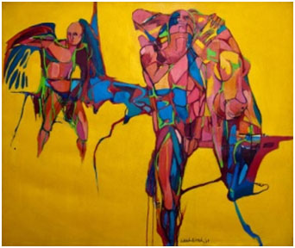
Angels Ordering Exiles from Paradise
After Karen Laub-Novak’s painting, “Exiles from Paradise”

